Slide 1
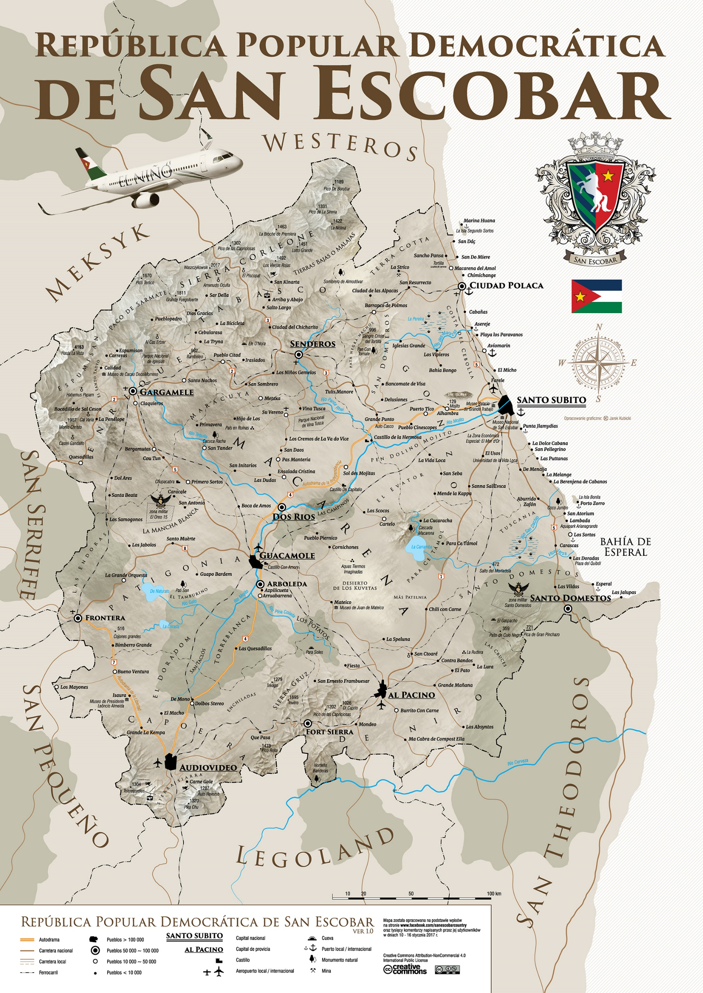
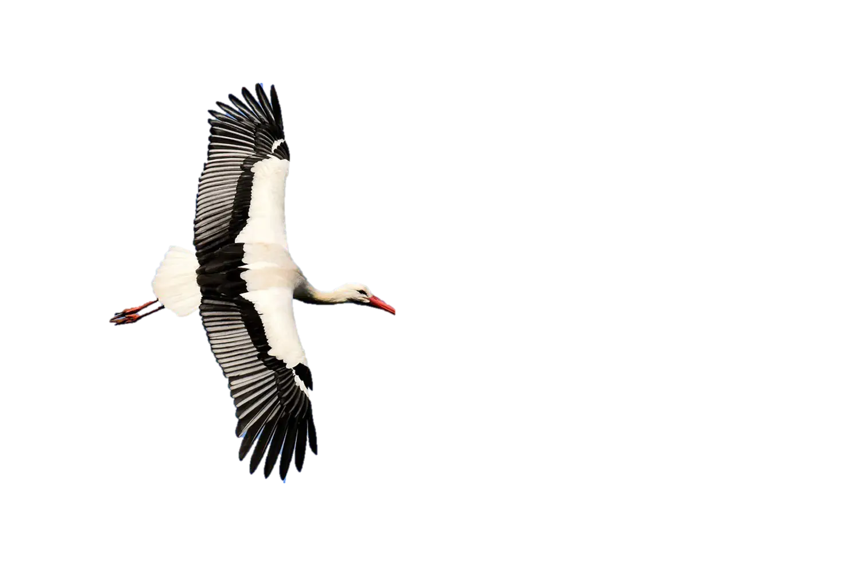
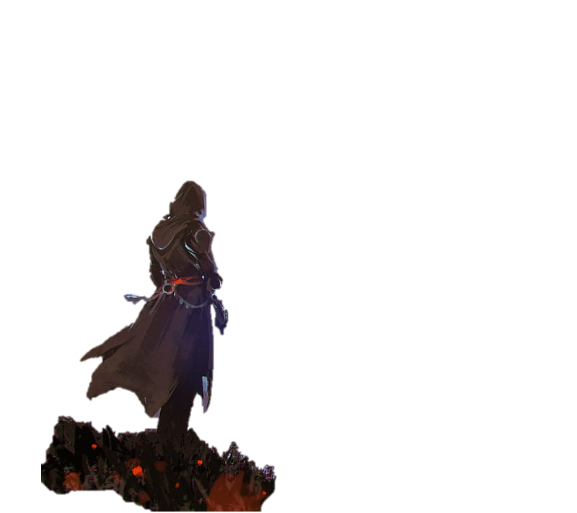
SAN ESCOBAR:
LIBERATION
A Codecool project

Slide 2
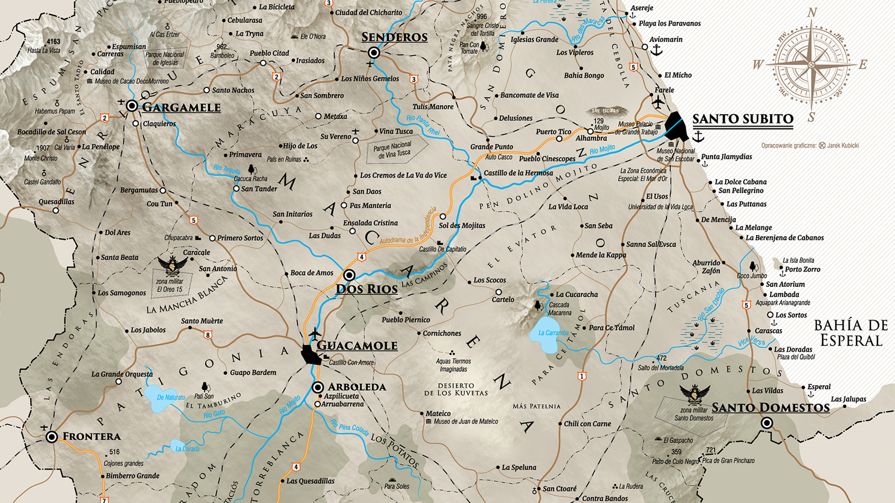
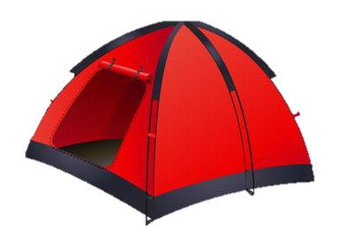
AGENDA
1. Project team
2. Used technologies
3. Sprint timeline
5. Game features
4. Task distribution
6. Demo
7. Future plans
8. Q&A session

Slide 3
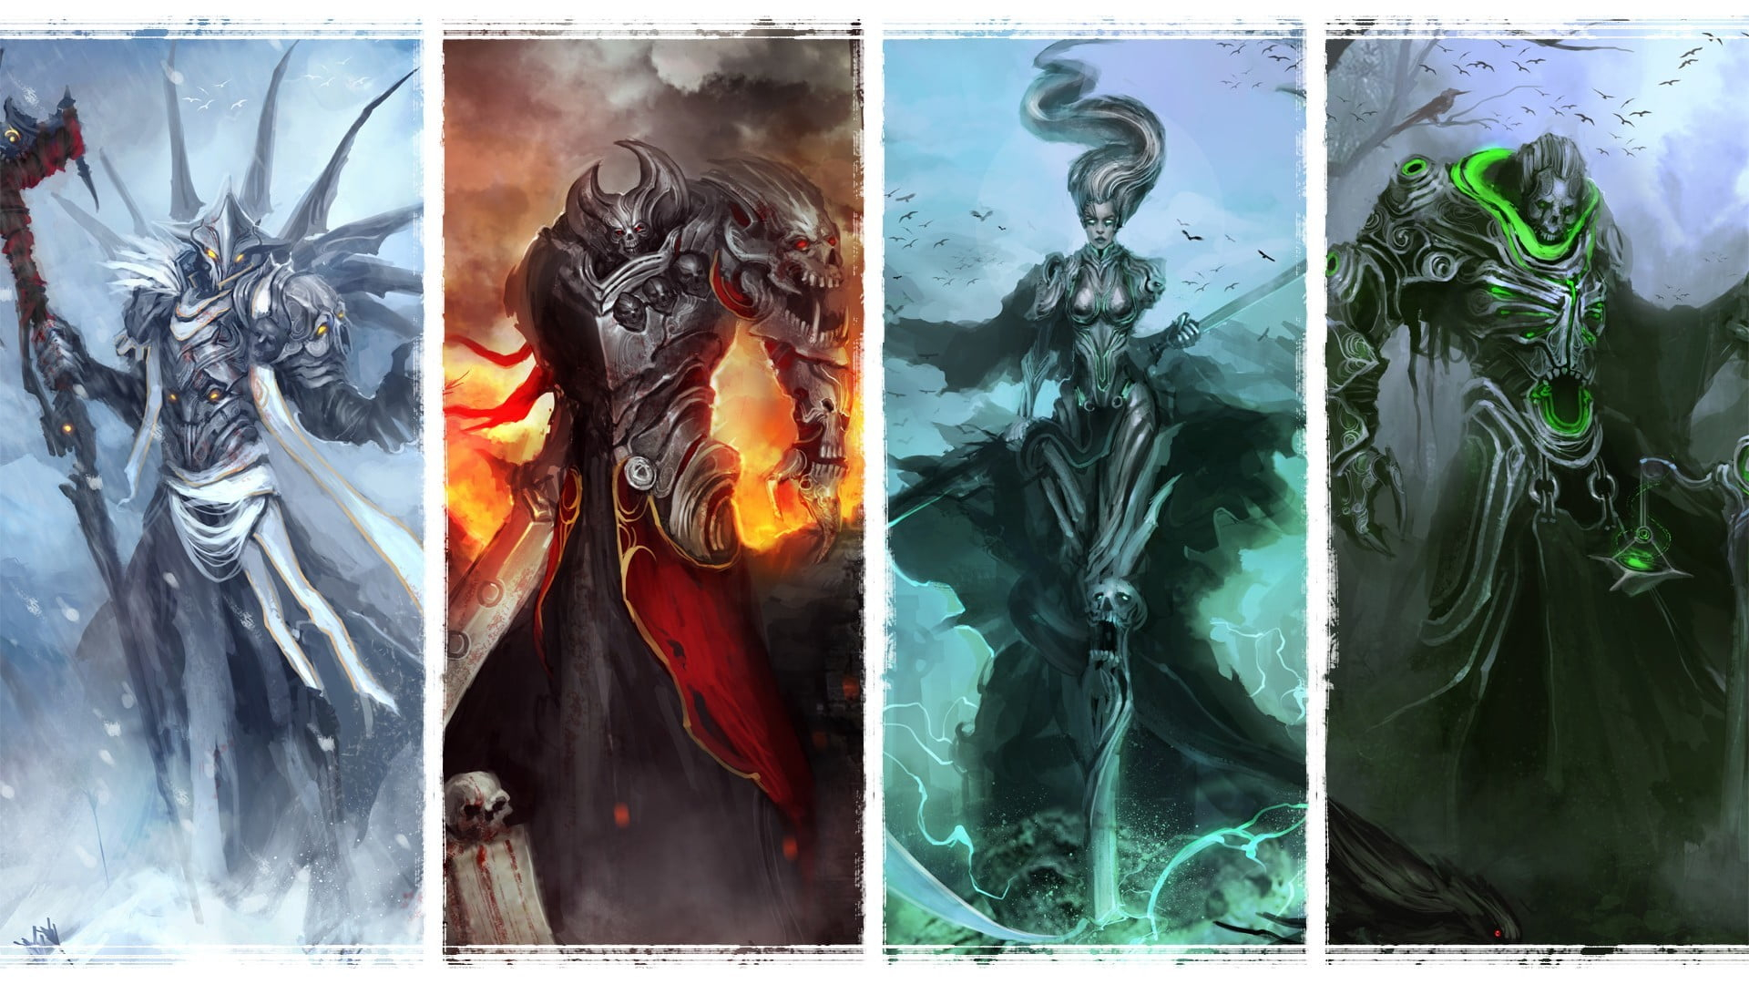
PROJECT TEAM
Marcin
Stodolny
Maciej
Trębacz
Martyna
Marcinkowska
Tomek
Citko

Slide 4
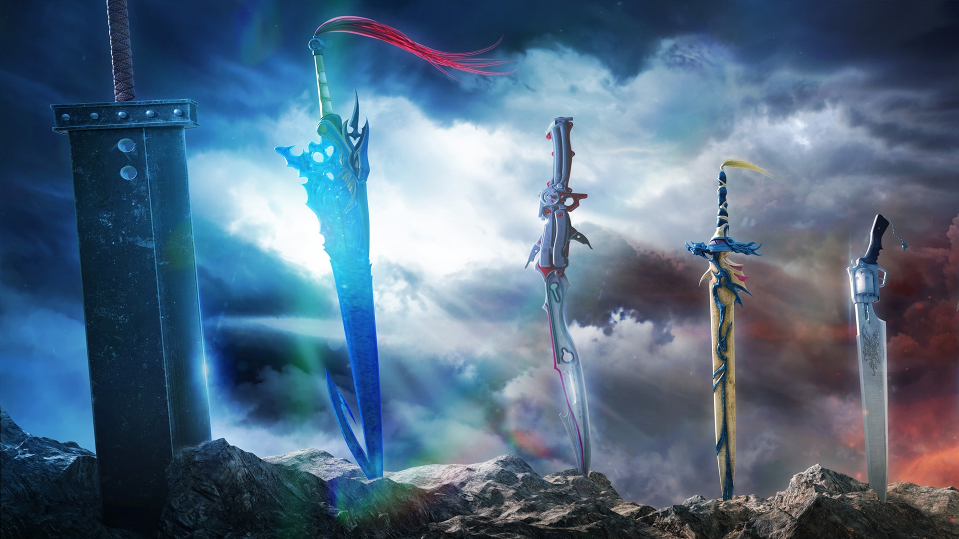





USED TECHNOLOGIES

Slide 5
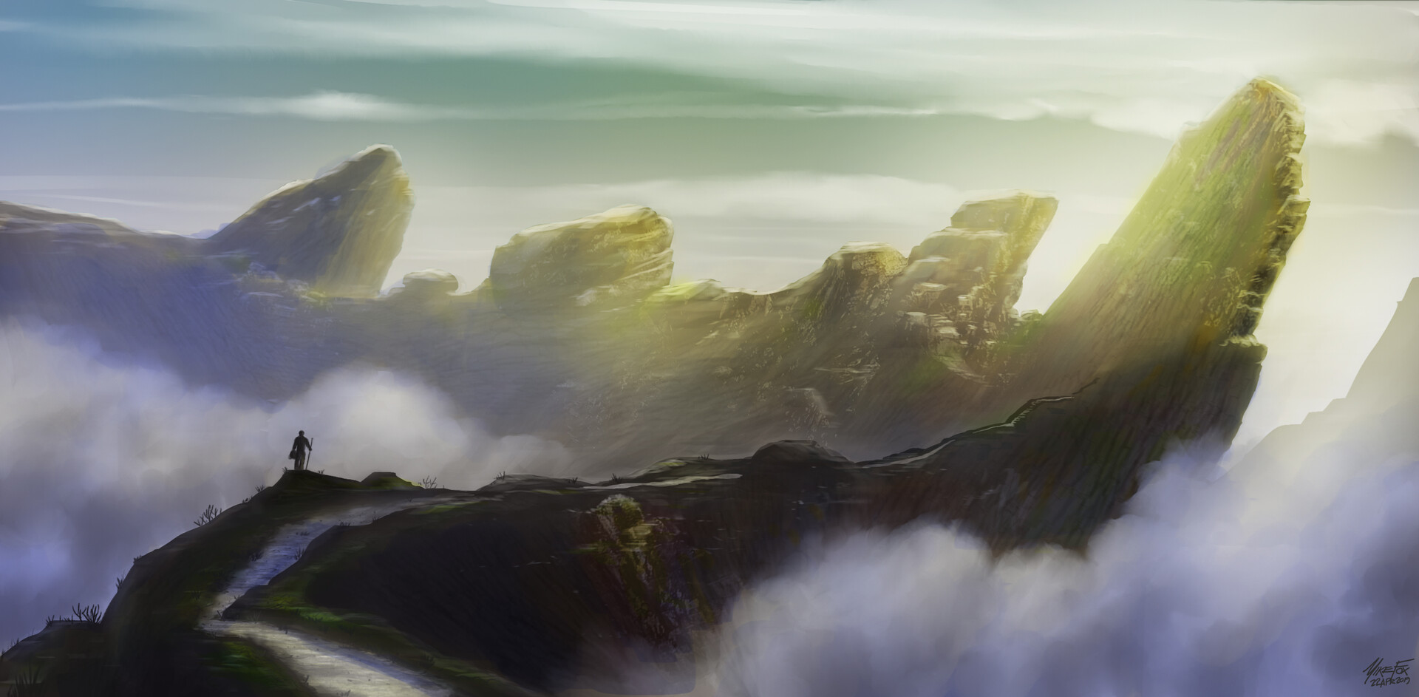
SPRINT TIMELINE
DAY 1
DAY 2
DAY 3
Board
Working movement
Items, story
Fight
Boss movement
New boards
Presentation
Bug fixing
Improved gameplay

Slide 6
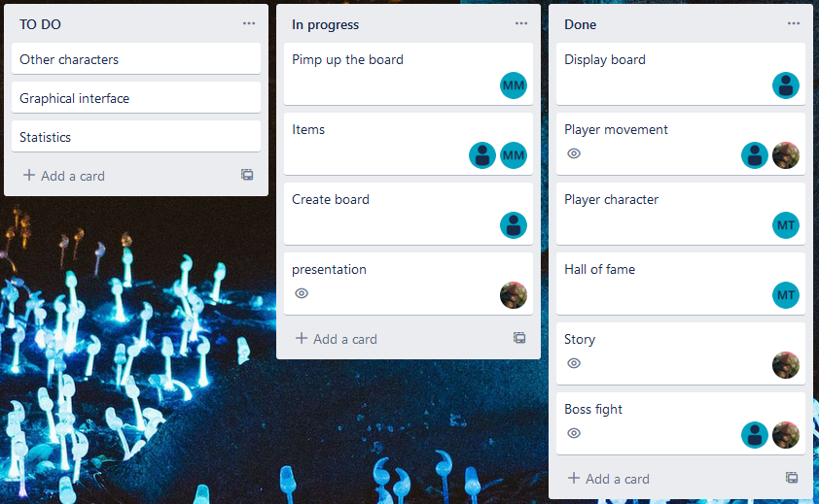
TASK DISTRIBUTION

Slide 7
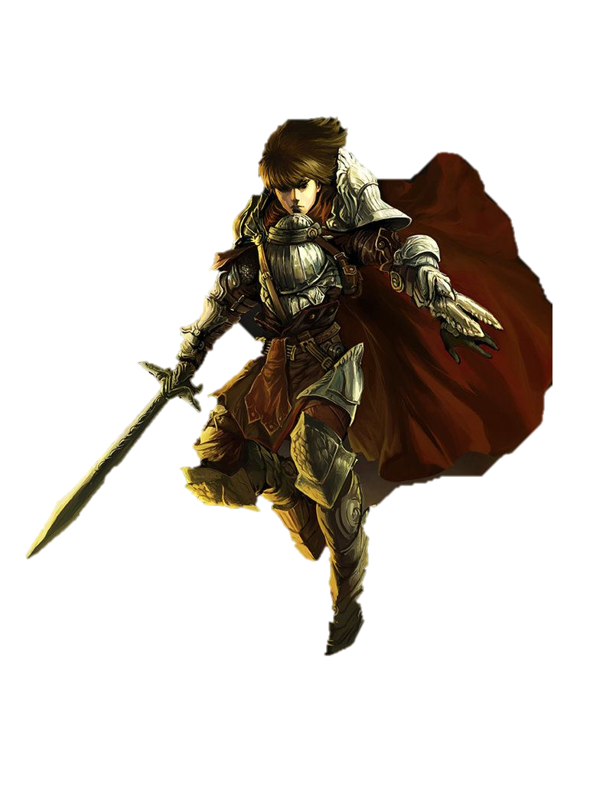
GAME FEATURES
Full Roguelike-RPG experience
Engaging combat
Player development
Epic story
Thrilling final boss fight
Hall of fame

Slide 8
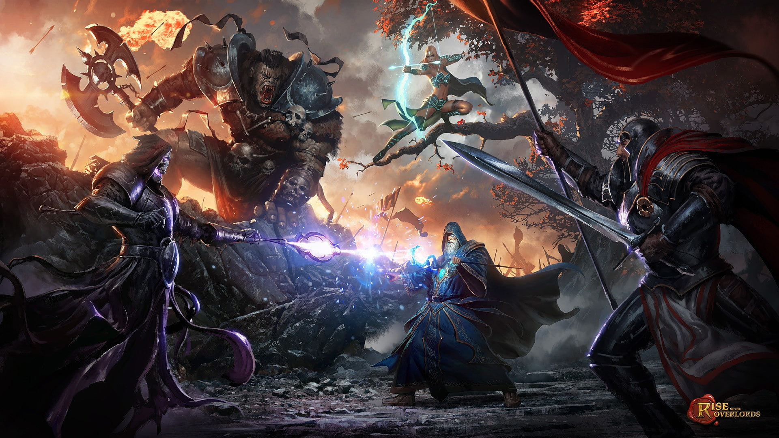
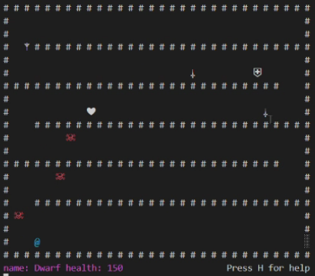
DEMO

Slide 9
FUTURE PLANS
On-line multiplayer
Improved combat (tic-tac-toe engine)
Implement VR
Expand map to the full San Escobar size
Add strategy mode with politics symulator to maintain good relationships with Poland

Slide 10
Q&A

